Slide 1
CBA API & Webservices
Modernization and Migration to AWS
Sep 3, 2024

Slide 2
Introduction
The API migration to DHP/AWS involves multiple legacy (on-premise | non-cloud) platforms in CBA
IFW – Information Framework (Legacy .Net 3.5 Webservice applications, totaling about 295)
EP – Enterprise Platform (Legacy IBM IID based webservice. Applications, totaling about 300)
MP – Microservice Platform (.Net 4.5/4.8 based Rest API’s, totaling about 175)
DP2 APIs totaling about 600 apps that need to be rehosted
The migration is expected to result in a modernized API platform built on latest technologies and simplified architecture, conforming to CBA blueprints and guardrails.
Multiple dispositions – rehost, refactor, rearchitect and retire – have been potentially identified for the services in scope
Few of the MP APIs (in HB domain) are already being rehosted in the CBA Cloud platform
Due to the inherent complexities, large volumes and tight coupling that characterize these services, CBA would like to identify the potential bottlenecks and risks associated with the migration before finalizing the ranking/order of migration and the correct dispositions
HCLTech proposes an approach for the same which involves a high level of automation augmented with its factory model for high throughput required for migration as per existing plan
The high-level approach and the tools finalized by HCLTech are the subject matter of this presentation and demo
2

Slide 3


Context
CBA is aiming to automate key areas as part of its modernization efforts:
Recursive Repo Scanning:
Automating the identification and impact analysis of changes in API code bases by scanning and analyzing all external dependencies recursively and generating a report detailing these dependencies and relevant info like the .NET Framework used.
Code upgrade with Iterative Learning:
Using an iterative process where initial code changes are made by a language model. Errors are refined through learning from further remediation of code done manually. Code generated should follow the API standards of CBA
Call Trace Analysis:
Automating the identification of upstream/downstream application interactions with APIs through configuration file scanning and providing a visual representation of these interdependencies.
Scaffold Generation:
Developing tools to automate the creation of boilerplate code for CBA's framework, specifically generating .NET Core equivalents for existing .NET 3.5-based services.
The remediated code will undergo full testing cycle before moving to production
3

Slide 4
High-level migration approach
HCLTech tools will be used to identify the right candidate dynamically at the start of each wave, through recursive code walkthrough and analysis
HCLTech will analyze existing in-house framework(s) of CBA and use its ADC tool to generate the parameterized templates needed for generation of boilerplate code
HCLTech will use both OEM tools and in-house accelerators to convert existing legacy code to modern stack before migration to AWS
Not a candidate for
modernization
Baselined code base
(IFW, MP, EP)
Intake Process
Use tool to identify entire dependency tree recursively
Identify interfaces to other services or APIs
Check if complexity is within limits
Modernize if yes. If not, iterate to identify
Modernization
Assess code & Iteratively accelerate remediation for standard patterns using tool suite
Fix any other issues manually
Prepare/ Update unit test and integrate with pipeline
Commit to repository
Needs CBA proprietary Framework?
Candidate for
modernization
No
Yes
To QA Testing and SDLC
processes of CBA
Remediated code base
(IFW, MP, EP)
Input
Code Scaffolding
Scan & Identify API template
Generate boilerplate code
Add business logic
Prepare/ Update unit test and integrated with pipeline
Commit to repository
Identify existing code scaffold for legacy applications
Identify changes for target environment
Generate template
ADC.NET
Output
4

Slide 5
Intake process
Parse code to identify
Dependent modules
.NET assemblies required
External interfaces
START
Select candidate for modernization
Identify repositories for dependent modules
Recursively parse code base for all dependent modules
Some formula to derive complexity based on number of dependent modules and difficulty of migrating assemblies to .NET Core
Not a modernization candidate. Select the next candidate
Convert data collected into tech docs for analysis
No
Candidate is selected for migration / modernization
Yes
Collate list of .NET assemblies
Check migration paths to Core
END
Is complexity low?
Most of the steps (colored in green) in the above process can be automated using AI Force
Need to identify a formula to classify an application as complex or simple, based on parameters derived from the code base
AI Force may internally leverage other OEM / in-house / 3rd party tools for one or more steps in the process

Slide 6
Modernization process
START
Candidate identified for modernization
Assessment of baselined code to identify changes required
Auto-remediation of code for known patterns
The remediated code will be fed to the LLM for reinforced learning for better outcomes in the next cycle during both prompt engineering and auto remediation
Check for hallucinations and rectify issues
END
Upload remediated code to repository
Develop & execute unit test cases. Fix bugs identified
Fix remaining issues manually
(prompt engg or experience)
The steps colored in green in the above process can be automated using AI Force
The efficiency and code fidelity of AI Force increases over time as it learns the optimal output expected every cycle
Level of manual remediation needed will also decrease over time

Slide 7
Code scaffolding
Analyze existing legacy CBA proprietary framework code
Identify changes needed for target environment
Develop .NET Core-compatible templates for components in CBA proprietary framework
Upload to template repository for future code generation
Template Generation (One-time)
Code Generation (Cyclic)
To be done manually. Needs analysis to determine how much of this code can be generated automatically from legacy code
Scan code to identify CBA proprietary components needed
Download templates and generate boilerplate code
Add business logic as required based on legacy code
Generate unit test cases. Execute and fix bugs identified.
Upload newly generated code to code repository
The steps colored in green in the above process can be automated using AI Force
Possibility of using AI Force to convert legacy framework components to modern framework will be determined after an analysis

Slide 8

Automation Approach for CBA
Known CBA Patterns | Target State | Intake Process | Code Scaffolding using ADC.NET accelerator | Modernize using Accelerator suite
 |  |  |  | DEFAULT | Code Generation | Additional Conversion
WCF (Web Services) | .NET8, Web API, EFCore-8.0 | AIForce.Specs | AIForce.Code | .NET Upgrade Assistant | AIForce. Upgrade for .NET ** | GitHub CoPilot
ASMX (Web Services) | .NET8, Web API, EFCore-8.0 | AIForce.Specs | AIForce.Code | - | AIForce. Upgrade for .NET ** | -
Web Forms( ASPX) (ASP .NET ( <=4.8 )) | .NET8, C# Razor Pages, Web API, EFCore-8.0 | AIForce.Specs | AIForce.Code | .NET Upgrade Assistant | AIForce. Upgrade for .NET ** | GitHub CoPilot
MVC / WEB API (ASP.NET v4.x) | .NET8, C# Razor Pages, Web API, EFCore-8.0 | AIForce.Specs | AIForce.Code | .NET Upgrade Assistant | AIForce. Upgrade for .NET ** | GitHub CoPilot
** HCLTech accelerator provides up to 60% savings in code level assessment & 50% savings in code remediation, but varies based on code base

Slide 9
Tools Prerequisites
S.No | Tool Details | Pre-reqs
1 | HCLTech AIForce.Upgrade for .Net | .Net Framework version 4.8 VC++ Redistributable for Visual Studio 2022 .Net8 Runtime
2 | AWS ToolKit For Refactoring | Visual Studio 2022 / VS Code AWS CLI on Dev Desktops AWS Account
3 | .NET Upgrade Assistant | Visual Studio 2019 or above / VS Code .Net >= 3.5
4 | GitHub CoPilot | Visual Studio / VS Code ( Latest Version ) .Net 5+ GitHub Subscription and GitHub Account
5 | Google Gemini | Visual Studio / VS Code ( Latest Version ) .Net 5+ Google Account

Slide 11

API Standards – Current Analysis
 | Standard | A. New API (~2023 onwards) | B. Modernised (legacy) API | C. Re-platformed / | Rehost | Refactor | Re Arch | Remarks | Current State
 |  |  |  | Re-Hosted (legacy) API
1 | API Type | REST, GraphQL, AsyncAPI with a properly defined API Spec v3.0 and JSON payload | REST, GraphQL, AsyncAPI with a properly defined API Spec v3.0 and JSON payload | Any | Yes | Yes | Yes | Rest API with a properly defined API Spec v3.0 & JSON Payload | The API Spec is v2.0, REST
2 | Is secured behind the relevant Group Domain Gateway | Required | Required | Required | NA | Yes | Yes | Consumer impact to be assessed as they need to update the way the API is consumed | Uses Consul via CBA DNS
3 | If External Facing - Is secured behind the relevant Group Edge Gateway | Required | Required | Required - IBM DataPower is acceptable solution | NA | Yes | Yes | Consumer impact as they need to update the way the API is consumed | Uses Datapower through Consul via CBA DNS
4 | Has an endorsed Service Domain, Crew and Owner | Required | Required | Required | NA | NA | NA |  | No service domain mapping
5 | Complies with the endorsed Enterprise Architecture Integration Guardrails | Required | Compliant with agreed exceptions | Non-compliant / legacy standards | Yes | Yes | Yes | As per the standard | As per the standard
6 | Is non-Monolithic in nature (That is, does not contain multiple business logic for multiple products/Service Domains) | Required | Required - Monolithic API’s to be split into discrete components | Non-compliant / legacy standards | NA | NA | Yes | Rehost and Refactor will be done on AS is API nature, breaking API to non - monolith will be assessed for Rearch | Is non-Monolothic but no service domain mapping
7 | Is fully documented and accessed managed (Scopes) in the Redocly API Catalogue | Required | Required | Documented in Redocly Only. | NA | Yes | Yes | Redocly API Catalogue can be used | Uses API Portal and does not use APICatalogue
 |  |  |  | Access Management (Scopes) via legacy processes
8 | Follows the endorsed Architecture patterns and guardrails for System API, Service API and XAPI | Required | Compliant with agreed exceptions | Non-compliant / legacy standards | NA | NA | NA | The service domain for the API's are to be assessed and the impact will be case by case | No, this does not fall under Service/System API
9 | Conforms to coding & linting standards as defined in the Redocly API Catalogue | Gold | Silver (As a minimum) | Baseline (As a minimum) | Yes (Baseline) | Yes (Silver) | Yes (Silver) | Can be aligned to the coding & linting standards as defined in the Redocly API Catalogue | Uses API Portal and does not use APICatalogue
10 | Is security compliant to CBA Standards | Fully Compliant | Compliant with all critical minimum standards - with agreed exceptions to other aspects | Compliant with all critical minimum standards | Yes | Yes | Yes | Compliant with all critical minimum standards | As per the standard
 |  |  |  | Anthony Barry to define ‘minimum’

Slide 12
API Standards – Current Analysis
 | Standard | A. New API (~2023 onwards) | B. Modernised (legacy) API | C. Re-platformed / | Rehost | Refactor | Re Arch | Remarks | Current State
 |  |  |  | Re-Hosted (legacy) API
11 | Complies with CBA Auth and Entitlements standards | Fully Compliant | Compliant with all critical minimum standards | Compliant with all critical minimum standards | Yes | Yes | Yes | Compliant with all critical minimum standards | As per the standard
 |  |  | Compliant with modern standards such as OAUTH 2, | Anthony Barry to define ‘minimum’
 |  |  | with agreed exceptions to other aspects
12 | Adheres to Observability Guardrails and guidance | Fully Compliant | Compliant with agreed exceptions | Non-compliant / legacy standards | Yes | Yes | Yes | Rehost - Non-compliant / legacy standards Refactor/Rearch - Compliant with agreed exceptions | As per the standard
13 | Performs API Health checking | Fully Compliant | Compliant with agreed exceptions | Non-compliant / legacy standards | Yes | Yes | Yes | As per the standard | As per the standard
14 | External facing APIs are Pen Tested | No Medium, High or Critical vulnerabilities present | No Medium, High or Critical vulnerabilities present | No High or Critical vulnerabilities present | NA | Yes | Yes | As per the standard | As per the standard
15 | Conforms to CBA workload placement policy | q | Required | Required | Yes | Yes | Yes | As per the standard | As per the standard
16 | Uses AWS CBA Whitelisted Services | Required | Required | Non-compliant / legacy standards | NA | Yes | Yes | As per the standard | Not applicable as they are hosted on-prem
17 | Uses approved datastores | Required | Required with agreed exceptions | Non-compliant / legacy standards | Yes | Yes | Yes | As per the standard | As per the standard
18 | For Service API’s, has a defined and agreed Data Product to CBA standards | Required | Required | Non-compliant / legacy standards | NA | NA | NA | The service domain for the API's are to be assessed and the impact will be case by case | No service domain mapping
19 | Consumes IFW or EP , or | Not permitted | Not permitted | Non-compliant / legacy standards | Non-compliant / legacy standards | Non-compliant / legacy standards | Non-compliant / legacy standards | No, The service domain for the API's are to be assessed and the impact will be case by case | Yes, consumes IFW,EP directly (or) via another MP API
 | Consumes an MP that in turn consumes IFW/EP

Slide 13
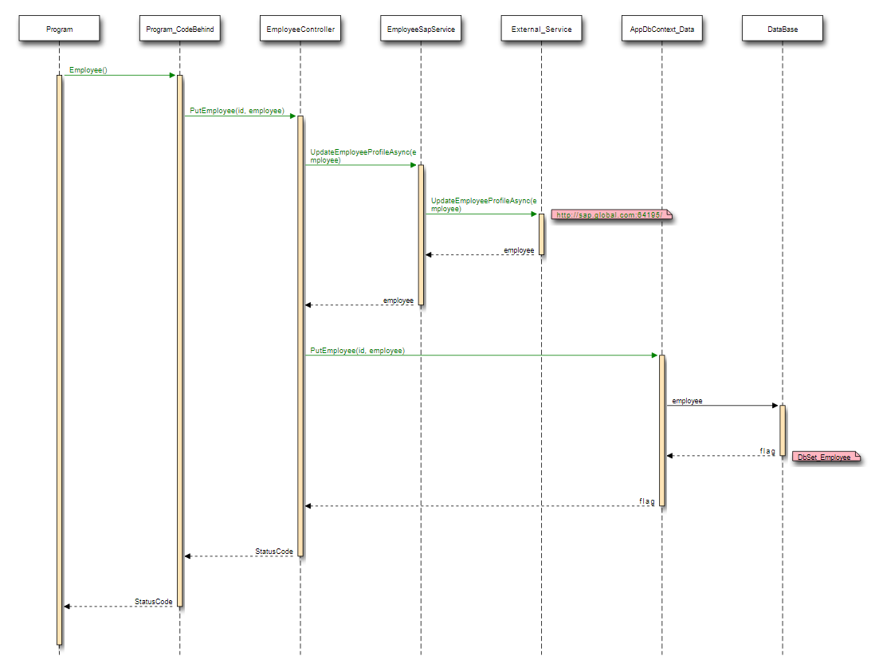

Slide 14
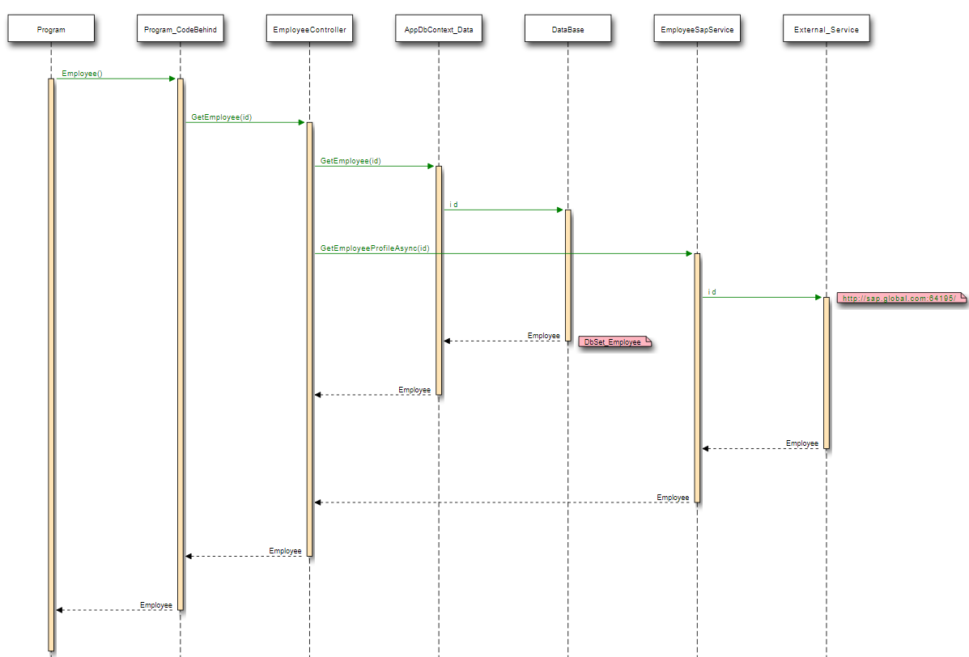

Slide 15
Dependencies
PackageId | Package Version | Framework | Is Custom? | GitUrl | DotNet8 Compatible? | DotNet8 Compatible Version | Alternate Library
Antlr | 3.5.0.2 | net45 | No | https://github.com/antlr/antlr4 | No |  | Roslyn
bootstrap | 3.3.7 | net461 | No | https://github.com/twbs/bootstrap | No |  | Telerik UI for Blazor
bootstrap | 4.3.1 | net45 | No | https://github.com/twbs/bootstrap | No |  | Blazorise or Telerik UI for Blazor
EntityFramework | 6.2.0 | net472 | No | https://github.com/dotnet/EntityFramework.Docs | Yes | 6.0.0 | N/A
jQuery | 3.3.1 | net45 | No | https://github.com/jquery/jquery | Yes
jQuery.Validation | 1.17.0 | net461 | No | https://github.com/jquery-validation/jquery-validation | Yes
Microsoft.AspNet.Cors | 5.2.7 | net461 | No | https://github.com/eduflornet/ApiMicroTiendaVirtual | Yes | 5.0.0 | N/A
Microsoft.AspNet.Mvc | 5.2.4 | net461 | No | https://github.com/Legends/Custom-SignInManager-for-MVC-5 | No | N/A | Microsoft.AspNetCore.Mvc
Microsoft.AspNet.Mvc | 5.2.7 | net45 | No | https://github.com/Legends/Custom-SignInManager-for-MVC-5 | No | N/A | Microsoft.AspNetCore.Mvc
Microsoft.AspNet.Razor | 3.2.4 | net461 | No | https://github.com/jasontaylordev/ContosoUniversity | Yes
Microsoft.AspNet.Razor | 3.2.7 | net45 | No | https://github.com/jasontaylordev/ContosoUniversity | Yes | 5.0.0 | N/A
Microsoft.AspNet.TelemetryCorrelation | 1.0.0 | net461 | No | https://github.com/aspnet/Microsoft.AspNet.TelemetryCorrelation | Yes | 2.0.0 | N/A
Microsoft.AspNet.Web.Optimization | 1.1.3 | net45 | No | https://github.com/gothandy/TC.Sitecore.Bundles | No |  | System.Web.Optimization
Microsoft.AspNet.WebApi | 5.2.7 | net45 | No | https://github.com/azzlack/Microsoft.AspNet.WebApi.MessageHandlers.Compression | Yes | 5.2.7 | N/A
Microsoft.AspNet.WebApi.Client | 5.2.7 | net461 | No | https://github.com/mauriciomarcos/Microsoft.AspNet.WebApi.Client | No |  | Microsoft.AspNetCore.WebApi.Client
Microsoft.AspNet.WebApi.Core | 5.0.0 | net461 | No | https://github.com/fatihsaridag/AspNetCore7-WebApi-Microsoft-Documentation-Work | Yes | 5.2.7 | N/A
Microsoft.AspNet.WebApi.Core | 5.2.7 | net45 | No | https://github.com/fatihsaridag/AspNetCore7-WebApi-Microsoft-Documentation-Work | Yes | 5.0.0 | N/A
Microsoft.AspNet.WebApi.Cors | 5.2.7 | net461 | No | https://github.com/eduflornet/ApiMicroTiendaVirtual | Yes
Microsoft.AspNet.WebApi.HelpPage | 5.2.7 | net45 | No | https://github.com/azzlack/Microsoft.AspNet.WebApi.HelpPage.Ex | Yes
Microsoft.AspNet.WebApi.WebHost | 5.2.7 | net45 | No | https://github.com/dotnet/aspnetwebstack | No | N/A | Microsoft.AspNetCore.Mvc.WebApiCompatShim
Microsoft.AspNet.WebPages | 3.2.4 | net461 | No | https://github.com/aspnet/AspNetWebStack | No |  | Microsoft.AspNetCore.Mvc
Microsoft.AspNet.WebPages | 3.2.7 | net45 | No | https://github.com/aspnet/AspNetWebPages | No |  | Microsoft.AspNetCore.Mvc
Microsoft.CodeDom.Providers.DotNetCompilerPlatform | 2.0.0 | net461 | No | https://github.com/rubenmamo/CVE-2017-0248-Test | Yes | 3.1.1 | N/A
Microsoft.jQuery.Unobtrusive.Validation | 3.2.4 | net461 | No | https://github.com/whyleee/Microsoft.jQuery.Unobtrusive.Validation | Yes
Microsoft.Web.Infrastructure | 1.0.0.0 | net45 | No | https://github.com/CaravelLabs/terraform-azure-starter | Yes | 1.0.0 | N/A
Modernizr | 2.8.3 | net45 | No | https://github.com/Modernizr/Modernizr | No |  | Modernizr.NET
Newtonsoft.Json | 13.0.2 | net45 | No | https://github.com/JamesNK/Newtonsoft.Json | Yes | 12.0.3 | N/A
Newtonsoft.Json | 6.0.4 | net461 | No | https://github.com/JamesNK/Newtonsoft.Json | Yes | 13.0.1 | N/A
popper.js | 1.14.3 | net45 | No | https://github.com/tvkhoa/react-tippy | No |  | Tippy.js
Respond | 1.4.2 | net45 | No | https://github.com/scottjehl/Respond | Yes | 2.0.0 | N/A
System.Diagnostics.DiagnosticSource | 4.4.1 | net461 | No | https://github.com/NLog/NLog.DiagnosticSource | Yes | 5.0.0 | N/A
WebApiContrib.Formatting.Jsonp | 3.0.2 | net461 | No | https://github.com/WebApiContrib/WebApiContrib.Formatting.Jsonp | No | N/A | Newtonsoft.JsonP
WebGrease | 1.6.0 | net45 | No | https://github.com/Licshee/WebGrease | No |  | Microsoft.Extensions.MSBuild.Sdk.Solution

Slide 16
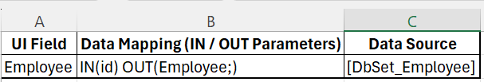
Mappings
List of Interfaces:
DB – GUI mapping:
Functional Description:

